Slide 1
DESIGNING A CLASSIFYING SYSTEM FOR NON-PROFIT ORGANIZATION WITH TEXTUAL CONTENTS IN THE MISSION STATEMENT
Heejae Lee*
Rutgers, The State University of New Jersey
Richard Dull
West Virginia University
Xinxin Wang
Rutgers, The State University of New Jersey

Slide 2
Agenda
Motivation
Introduction
Data Collection
Data Preprocessing
Methodology
Result
Conclusion

Slide 3
Motivation
According to the National Center for Charitable Statistics (NCCS), there are more than 1.5 million nonprofit organizations registered in the United States (McKeever, 2018).
Form 990 (officially, the "Return of Organization Exempt From Income Tax") is Internal Revenue Service form that provides the public with financial information about a nonprofit organization (Public Information).

Slide 4
Introduction
Comparing the entity with peer benchmark can provide better understanding of the entity’s performance.
For NPOs, NTEE (National Taxonomy of Exempt Entities) classification is widely used.
Some researchers argue that the NTEE system works poorly in terms of identifying NPOs pursuing similar objectives.
Around 14% of the non-profit organizations are classified as ‘Human Service (P)’ organization.
Only 42 out of 277 nonprofit organizations provide homeless housing in Washington are actually coded as “Housing & Shelter (L)” organizations by the NTEE system.

Slide 5
Introduction (Cont’)
The mission statements of NPOs have the potential to improve the nonprofit classification system from the accountability perspective.
The purpose of this study is to design a new classifying system for NPOs with the textual content of their mission statement.
The new classification will allow the information users to evaluate effectiveness and efficiency of the non-profit organizations.

Slide 6
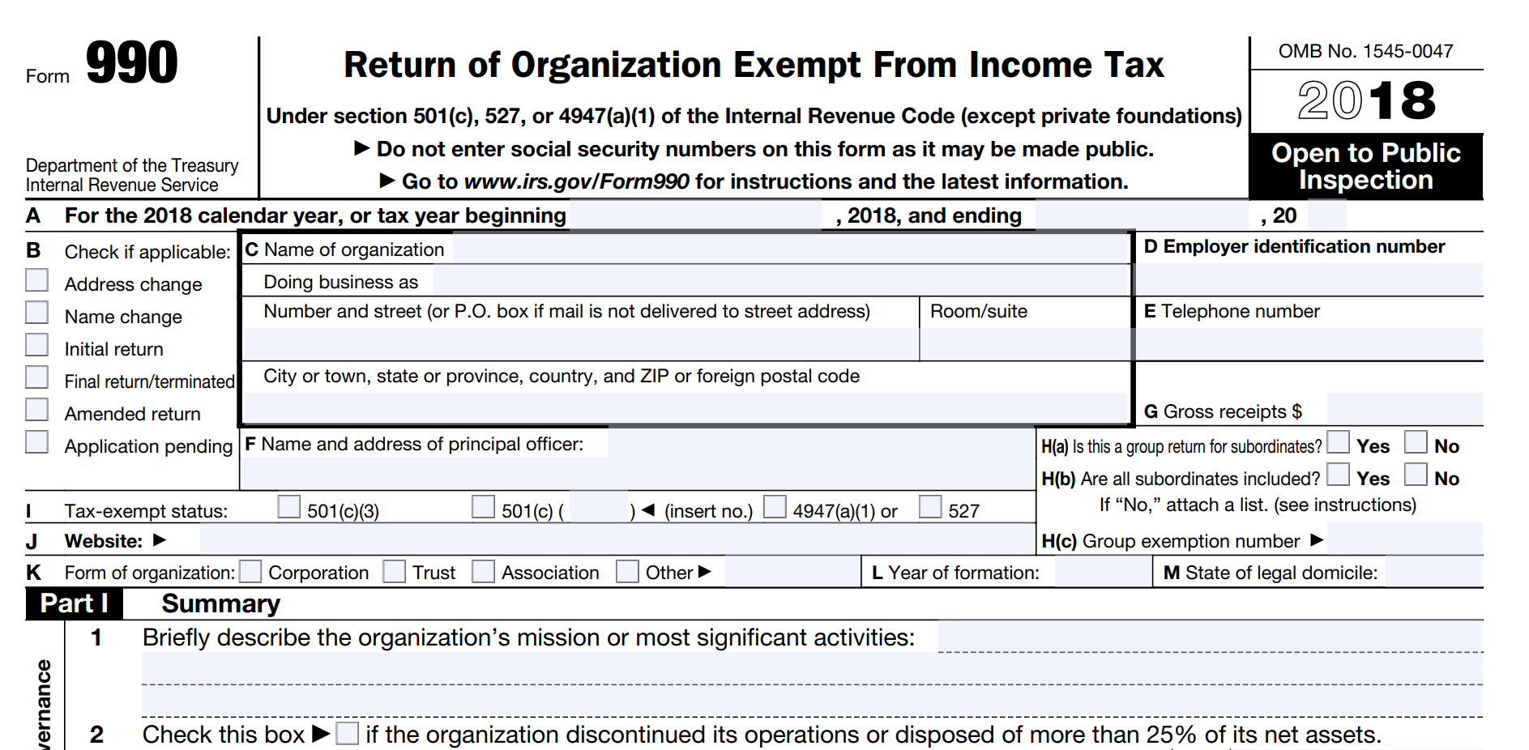
Data Collection
Collect filed Form 990 of nonprofit organizations for tax year 2016 from the Amazon Web Services (AWS) database
Link Form 990 database and “Current Master NTEE Lookup file” from NCCS Data Archives using Employer Identification Number (EIN)
Use Form 990 Part I Summary Question 1 as a mission statement (If it’s not available, use Part III Question 1 instead.)

Slide 7
Data Collection (Cont’)
 | Numbers
Whole Population from Form 990 database | 80,631
Not available in Current Master NTEE Lookup file | 4,847
Duplicate EIN code | 239
‘see schedule’ in the mission statement | 879
‘attachment’ in the mission statement | 48
‘501’ in the mission statement | 1,032
Mission Statement is Missing | 2
Final Sample Size | 73,584

Slide 8
Data Preprocessing
Mission Statement
Remove numbers
Remove punctuation
Remove stop words
Stemming words
Convert to vectors

Slide 9
Methodology
Randomly split the data into training (80%) and test (20%) data
Training data (Total 58,867 entities) and Test data (Total 14,717 entities)
For testing sample, total 1,785 entities are labeled as ‘Housing & Shelter’ organizations. (1,070 entities are classified as ‘L’ organizations)
Focus on Housing & Shelter Organizations (NTEE ‘L’)
Use keywords to label the mission statement
Use two machine learning algorithms (Boosting classifier and Naïve Bayesian classifier)

Slide 10
Methodology (Cont’)
The list of keywords used for labeling
Keywords
affordable hous temporary shelter temporary hous emergency shelter group home homeowner low income homeown low hous low incom hous rental hous | home ownership affordable home apartment low income home home owner provide hous residential build home living facilit senior hous | family hous accessible hous housing for elder housing to elder housing for low rental housing facilit housing to disable homeless people section 8 | low income elderly hous housing homeless famil shelter home maintenance home repair homelessness *animals *pets *dogs
Notes:
Removed the animal shelter from the label

Slide 11
Result - Classification Report
Housing & Shelter Organization? | Precision | Recall | F1-Score
Multinomial Naïve Bayesian
No | 0.98 | 0.95 | 0.96
Yes | 0.68 | 0.85 | 0.76
Boosting
No | 0.98 | 0.99 | 0.99
Yes | 0.95 | 0.87 | 0.91
NTEE code
No | 0.95 | 1.00 | 0.97
Yes | 1.00 | 0.60 | 0.75
Notes:
Precision TP/TP+FP
Recall (Sensitivity) TP\Positive

Slide 12
Result - Confusion Matrix
 | Naïve Bayesian |  |  | Boosting |  |  | NTEE code
Predict Label | No | Yes | Error | No | Yes | Error | No | Yes | Error
No | 12229 | 703 | 5% | 12857 | 75 | 0.6% | 12932 | 0 | 0%
Yes | 274 | 1511 | 15% | 234 | 1551 | 13% | 715 | 1070 | 40%
Notes:
False negative error rate is 15%

Slide 13
Result - Comparison Analysis
Compare Three samples using independent T-test
Exclude if the revenue is smaller than $5000.00
 |  | T-statistics | P-value
Program efficiency
Program Expenses divided by Total Expenses | NTEE vs Boost | 2.1936 | 0.0284*
 | NTEE vs Naïve Bayesian | 2.5030 | 0.0124*
Public Support
Total Contribution by Total Revenue | NTEE vs Naïve Bayesian | -2.8644 | 0.0042*
 | NTEE vs Boost | -3.116 | 0.0019*
Program Revenue divide by Total Revenue | NTEE vs Naïve Bayesian | 4.6960 | 0.0001*
 | NTEE vs Boost | 3.6938 | 0.0002*
Financial Distress or Vulnerability
Profit Margin | NTEE vs Naïve Bayesian | -2.2097 | 0.02725*
 | NTEE vs Boost | -2.1618 | 0.0308*
Notes:
Boosting, Naive B, NTEE, newly classification, excluded, set up the new benchmark, comparison analysis, difference groups

Slide 14
Result - summary
1629
Boosting classifier and Naïve Bayesian classifier showed lower false positive rate (13%, 15%, respectively) than NTEE (40%).
Boosting classifier showed lower error rate (higher accuracy rate) (2.5%) than Naïve Bayesian classifier (6.5%) and NTEE (4.9%)
New samples of Boosting and Naïve Bayesian are significantly different from NTEE sample.

Slide 15
Conclusion
A new classification algorithm using NPOs’ mission statements allow us to draw larger sample of “Housing & Shelter” organizations compare to NTEE code.
The mission statement have potential to improve traditional classification system of NPOs.
New sample of Housing & Shelter organizations are significantly different from NTEE sample.

Slide 16
Conclusion(Cont’)
Limitations
Use keywords to label organizations
Only focus on ‘Housing & Shelter’ organizations
Next Step
Identify outliers among the peer group using new classification system
Contribution
Fundraising
Donor relationship/ social engagement
Accountability and Transparency

Slide 17
Thank you
Please Contact Us:
Heejae Lee
heejae.erica.lee@rutgers.edu
Xinxin Wang
xw234@rutgers.edu

